Slide 1
CS2164 Lesson 9: More Functions Feb 24, 2016
Intro to programming using C
Instructor: Gustavo Sandoval
gustavo.sandoval@nyu.edu

Slide 2
From last class

Slide 3
Functions
Equivalent to what other languages call subroutines or procedures
It’s a chunk of statements grouped together and given a name
You can call it repeatedly by writing the name
For example a greeting function
Example: greeeting.c
Notes:
Have been using them all along already
Main is a function (special one)

Slide 4
Function Design
Useful not only for repeated use of functionality
But also for breaking down a problem.
For example:
Write a program that prints each line of its input that contains a particular string.
Functionally can be decomposed into:
While (MoreLInes()
If LIneContainsPattern()
Print it

Slide 5
Functions and Local Variables
A function is a complete program subunit
You can declare variables within it just like you can on main
The variable *scope* is just within the function
Variables declared inside a function are called Local variables
Local Variables only exist within the scope of a function.
Every time you enter the function the local variable is created and initialized all over again.
Example:
Locals.c

Slide 6
Returning values
So how do we return values ?
One option is returning a value with the return statement
Example:
Return.c
Notes:
A lot of this we have seen

Slide 7
Passing values
Two options:
By Value
By Reference
We have only used by value which doesn’t change the *value*.
By reference we pass the **address** of the variable in memory so that we can change it.
See example:
Passby.c

Slide 8
Multiple files in a program
Header files
Other c files
Demo:
lesson9/bigprog
How to compile:
 | produces
cc -o fib fibonnaci.c main.c | Fib.exe
cc fibonnaci.c main.c | a.Exe (out)
Cc *.c | .exe (out
Notes:
Important stuff:
Notice where to put the

Slide 9
Multiple files
Notice:
Preprocessor directtives are in the header file
Include “fibonacci.h”
#define MAX
Different way to compile

Slide 10
Storage Classes
Every variable and function so far has only had type:
Int, char, etc
In C, variables and functions have two attributes: Type and Storage class.
There are 4 storage classes:
auto
extern
register
static

Slide 11
Auto storage class
Is the default
The one we have been used so far
Variables declared within the function bodies
Examples:
auto int a, b, c;
auto float f;
Which we end up writing as:
int a, b, c;
float f;

Slide 12
extern
One method of transmitting information across blocks or functions is to use external or global variables.
When a variable is declared outside a function storage is permanently assigned to it and it’s storage class is extern.
BE CAREFUL because this leads to many issues.
Example:
Global.c

Slide 13
Another use of extern
When you have multiple files
It means look for it elsewhere.
This ability is huge when compiling large programs.
External variables never disappear they exist through the execution of the program
However they can be hidden by local declarations.
Example:
Extern/fct.c
Extern/main.c

Slide 14
register
It’s a hint to the compiler that this variable should be stored in memory registers
The compiler can ignore the hint if there are no free registers and then it becomes an auto variable.
Example:
{
register int i;
for (i = 0; i < LIMIT; i++)
}

Slide 15
static
Allows a local variable to retain its previous value when the block is reentered.
Another usage is for limiting scope of variables or functions.
Static functions are only visible within the file they are declared. Used for modularity and privacy.
Example:
Static.c

Slide 16
Default Initialization
External and static variables that are not explicitly initialized in our program are initialized to 0 by the system.
Automatic and register variable are NOT and will likely contain garbage values.
IMPORTANT:
Initialize your automatic variables.

Slide 17
RECURSION Definition
A function is called recursive if it calls itself
To do smaller and smaller work
Recursive functions follow a pattern:
Base case
Recursive case

Slide 18
Example:
Remember about the factorial definition:
N! =>
1 if n <= 1
(n -1)! * n if n > 1
Example:
File: Factorial.c

Slide 19
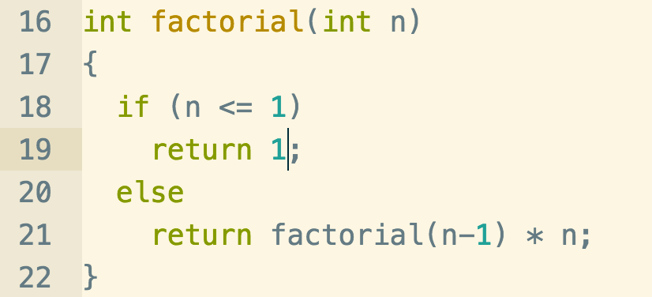
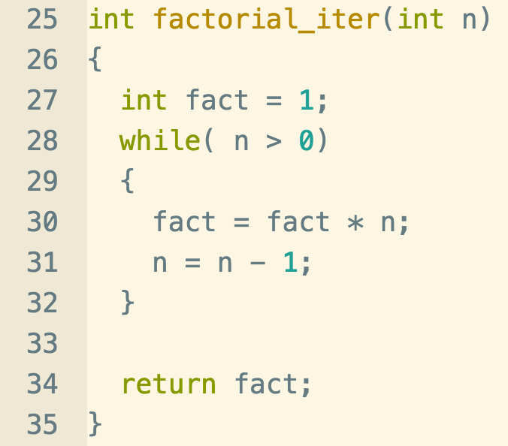
Factorial iterative vs recursive

Slide 20
Another Example
with seed values^{[1][2]}
or^{[5]}
We have already seen it !
Remember fibonnacci?
It’s defined as:
F(N) = F (N - 1) + F(N – 2 )
F(1) = 1
F(0) = 0
How do you write it with recursion ?
Notes:
https://en.wikipedia.org/wiki/Fibonacci_number#cite_note-FOOTNOTELucas18913-5

Slide 21
One more example
Wrt_backwards.c

Slide 22
Exercise
Write a recursive function called sigma with a prototype of
int sigma (int n);
that adds the numbers 1 through n and returns the sum.
Make sure that it works by also writing the iterative version
Example:
Enter a positive integer: 5
Sigma is 15

